Slide 1

Graph Editor using Javascript
→ An Interactive Tool to Create, Edit, and Visualize Graphs and Algorithms
Presented By: Ajay Kumar (CSB22060)
Guided by: Dr. Utpal Sharma

Slide 2
Project Overview and Purpose
What is the Project?
Educational Value
A web-based tool to draw, edit, and visualize graphs.
Designed to support students and educators in learning graph algorithms easily.
Built using HTML5, JavaScript, and the Canvas API.
Helps users understand graph algorithms through animated step-by-step execution.
Offers an intuitive interface for experimenting with BFS, DFS, Dijkstra, and Bellman-Ford.
Ideal for classroom teaching, self-learning, and demonstration purposes.

Slide 3
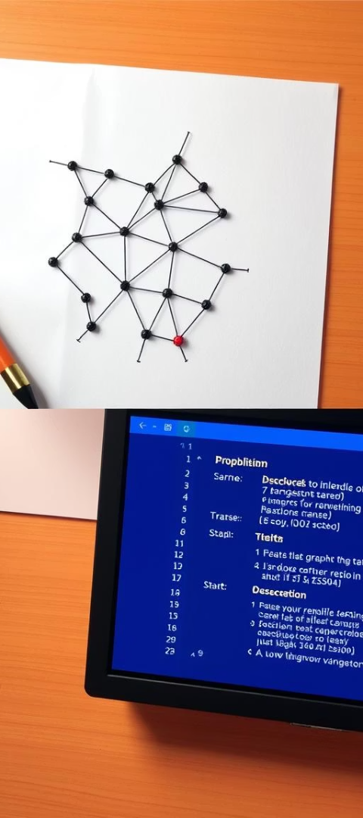



Problem Statement and Existing Limitations
Problem Definition
Drawbacks of Existing Systems
Understanding graph theory and algorithms is challenging without visuals.
Complex and not user-friendly
Don’t show step-by-step execution
Learners struggle to understand the how Algorithms works step by step.
Often need installation or login
Proposed Solution
Our web application allows users to create and manipulate graphs directly in the browser, offering interactive, step-by-step algorithm visualizations with animation controls and real-time statistics.

Slide 4
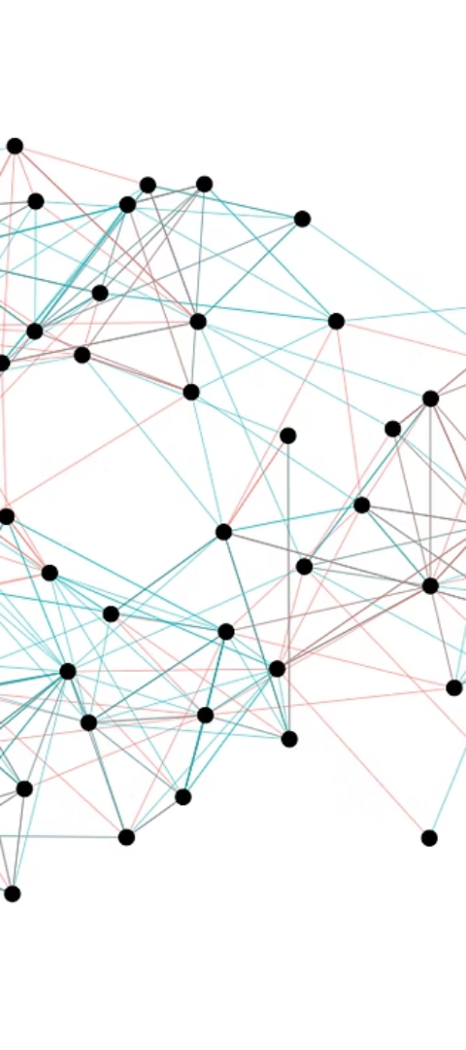
Key Features
Create, drag, and remove nodes and edges
Set edge weights using a modal
Toggle between directed and undirected graphs
Undo actions, reset canvas, save/load graphs as JSON
Visualize algorithms: BFS, DFS, Dijkstra’s, Bellman-Ford
Animated step-by-step execution with real-time stats

Slide 5
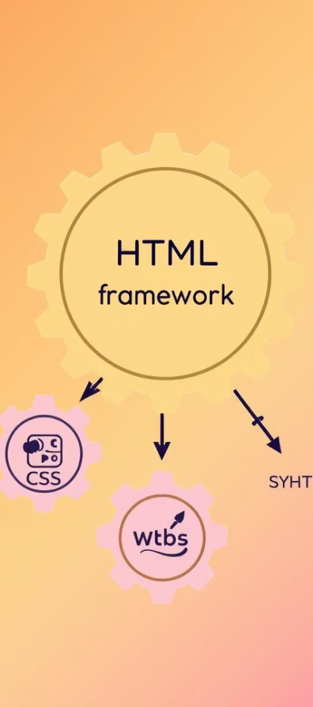




Tech used & System Architecture
HTML5
CSS & Bootstrap
JavaScript
Provides the basic structure of the web page, including the canvas element for rendering graphs.
Implements all business logic for user interaction, graph operations, rendering, and animations, making the tool interactive.
Used for styling, layout, responsiveness, and consistent UI elements, ensuring a modern and clean interface.
Web Worker
Offloads computationally intensive algorithms to a background thread, ensuring the UI remains responsive and preventing freezing.

Slide 6
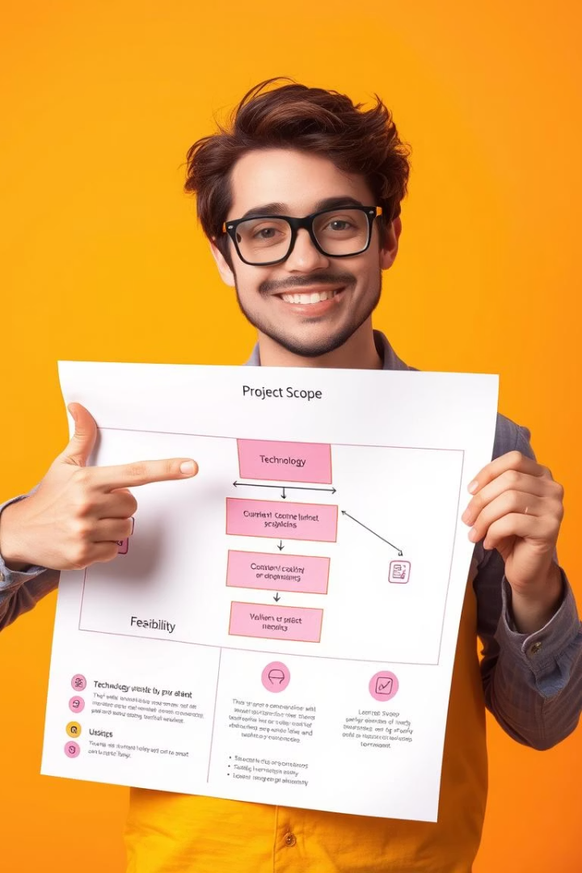
Project Scope and Feasibility
Project Scope
The project focuses on building a user-friendly graph editor with major algorithm visualizations, graph saving/loading, and responsive design for desktop. It's ideal for educational purposes, bridging theory and practice.
Technical Feasibility
Achievable with standard web technologies (HTML5, JavaScript, Canvas API, Web Worker). JavaScript handles logic, Canvas draws graphics, and Web Worker prevents UI freezing during complex algorithm execution.
Operational Feasibility
User-friendly design for students and teachers, with no complicated setup or installation, making it easy to use and manage.

Slide 7







System Analysis and Data Flow
Algorithm Execution
User Interaction
Output Display
Users interact by clicking buttons or entering data, such as adding nodes or selecting algorithms.
Graph Management
Selected algorithms process the graph in the background, ensuring smooth UI performance.
Final results, messages, and graph statistics are presented in the output panel.
The graph structure (nodes and edges) is updated and stored based on user input.
Input Handling
File Operations
Canvas Rendering
The system captures user actions and directs them to the appropriate program component.
Users can save or load graphs using the integrated file manager.
The graph and algorithm steps are visually drawn on the canvas.

Slide 8
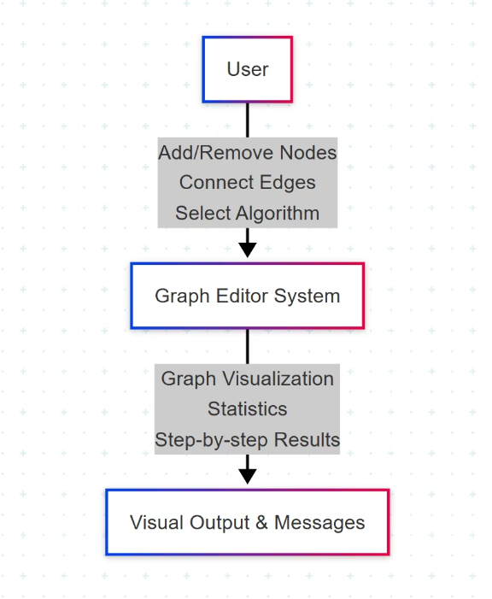
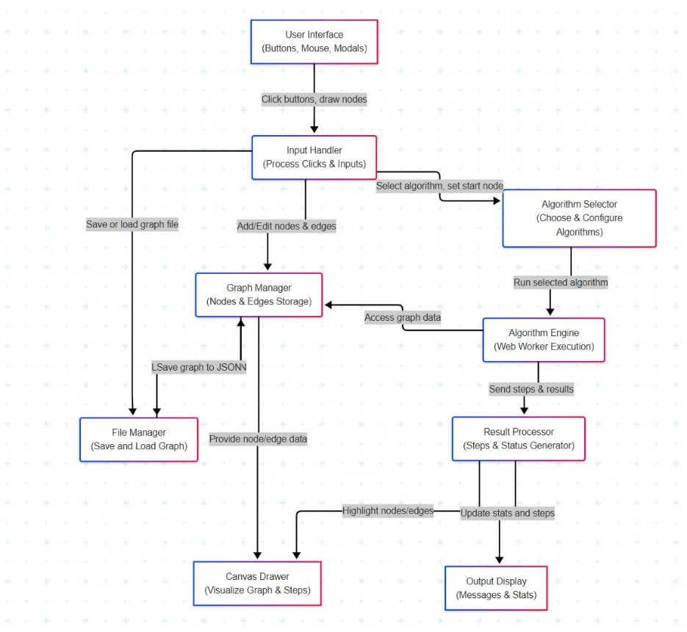
DFD (Data Flow Diagram)

Slide 9
Algorithm Design and Implementation
Breadth-First Search (BFS)
Dijkstra’s
Performs level-order traversal using a queue to find the shortest path in unweighted graphs.
Finds the shortest path from a source node to all other nodes in graphs with non-negative weights.
Depth-First Search (DFS)
Bellman-Ford
Explores paths by going as deep as possible before backtracking, using recursive or stack-based traversal.
Finds shortest paths in graphs with negative weights and detects negative-weight cycles.
All algorithms are implemented in a Web Worker to ensure a smooth user experience by avoiding UI blocking. Each step is visualized using colour changes and arrows, with animation controls for user interaction.

Slide 10
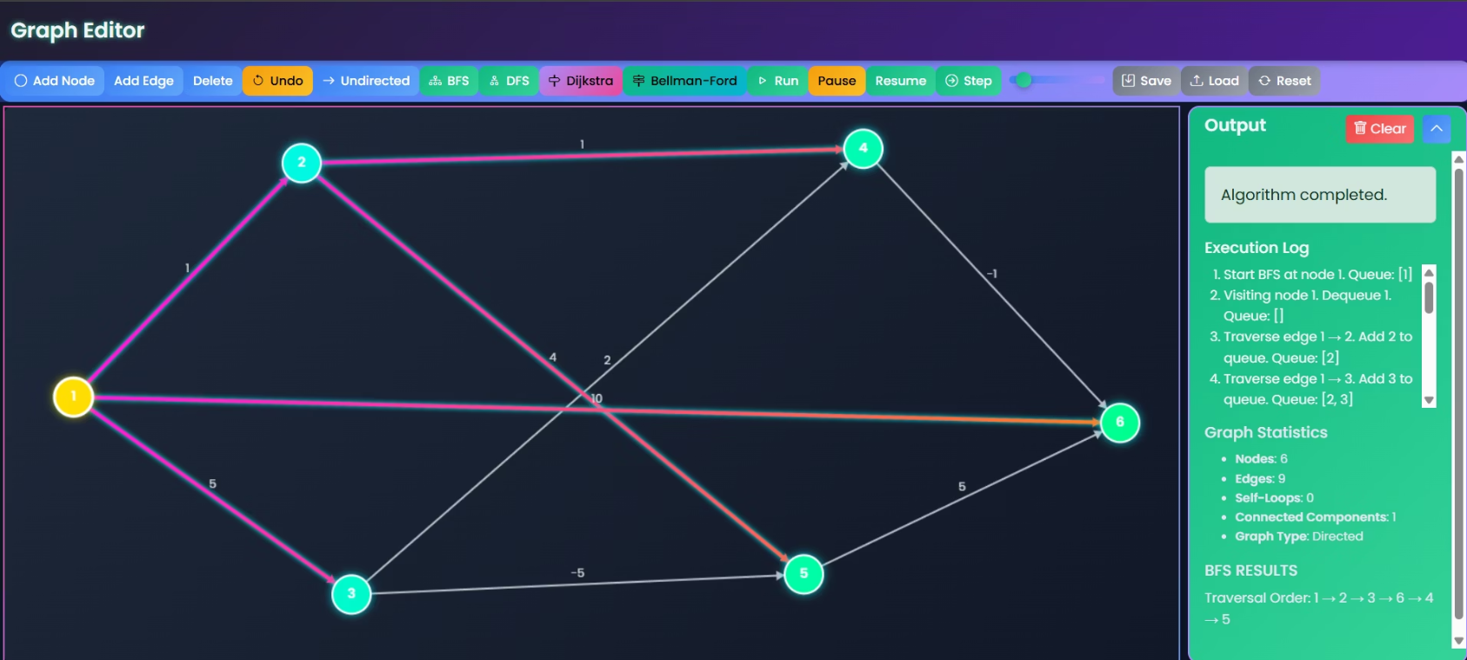
Visual Demonstration:

Slide 11




System Testing and Limitations
Successful Testing
All core functionalities, including graph creation, algorithm execution, and data management, passed manual test cases, ensuring reliability and correctness.
Performance Constraints
Noticeable lag may occur with graphs exceeding 50 nodes or 100 edges due to HTML5 Canvas's pixel-based rendering, which redraws the entire scene on every change.
Feature Limitations
Lacks zoom/pan, keyboard navigation, and support for advanced algorithms like A*, Kruskal’s, and Prim’s. Mobile editing is not fully functional due to touch input limitations.
Error Handling
Minimal validation for inputs like edge weights and start node IDs. Some invalid edge cases may not be caught gracefully, potentially leading to visual glitches.

Slide 12
Learning and Future Scope
Key Learnings
Future Work
Developed a strong understanding of JavaScript, Canvas API, and DOM manipulation.
Add advanced algorithms like A*, Kruskal’s, and Prim’s.
Implement zooming, panning, and better navigation for large graphs.
Learned how to structure modular and maintainable code.
Enhance accessibility with dark mode and keyboard shortcuts.
Gained practical knowledge of graph algorithms and their implementation.
Improve mobile compatibility and touch support.
Explored the use of Web Workers for smooth and responsive UI.
Allow exporting graphs as images or PDF.
Add robust input validation and error handling.
Improved skills in debugging, UI design, and user interaction handling.

Slide 13


Conclusion
This project was a great learning experience. I built a simple and useful tool to understand graph algorithms in an easy and visual way.
It helped me improve my coding, problem-solving, and design skills.
Thank You
Thank you for your time and support. I enjoyed working on this project and I’m excited to keep learning and growing.

